Slide 1

6. Configure Applications for Reliability

Slide 2
Application High Availability with Kubernetes
Concepts of Deploying Highly Available Applications
High availability (HA) aims to make applications resilient to runtime failures, reducing downtime. HA protects applications from:
• Application bugs
• Environmental issues like networking problems
• Resource exhaustion caused by other applications
It also helps protect the cluster from faulty applications, such as those with memory leaks.
Writing Reliable Applications
While cluster-level HA mitigates failures, fixing application-level issues is essential. HA complements but doesn’t replace developer solutions. Kubernetes expects applications to:
• Handle restarts
• Respond to health probes (startup, readiness, and liveness)
• Support multiple instances
• Use resources efficiently
• Operate with limited privileges
Applications adhering to these behaviors maximize Kubernetes’ HA capabilities. Typically, applications provide a health check endpoint, helping the cluster monitor their state. Developers decide how this endpoint reflects application health, like checking database connectivity when needed.

Slide 3
Kubernetes Application Reliability
When a pod crashes, Kubernetes can automatically restart it if properly configured. With health probes, the cluster can detect unresponsive applications and take action.
Key HA techniques include:
• Restarting pods: Configured restart policies automatically restart faulty pods.
• Probing: Health probes detect unresponsive applications and trigger corrective actions.
• Horizontal scaling: Adjusts the number of replicas based on application load.

Slide 4
Application Health Probes in Kubernetes
Kubernetes Probes Overview
Health probes help maintain cluster robustness by repeatedly checking application health. They enable:
• Crash mitigation: Automatically restarting failing pods
• Failover and load balancing: Directing traffic to healthy pods
• Monitoring: Identifying when pods fail
• Scaling: Recognizing when a replica is ready for requests
Authoring Probe Endpoints
Developers should create efficient health probe endpoints that indicate application health. For example, an application might report healthy only if it connects to its database. Since the cluster frequently calls these endpoints, they should be quick and avoid complex operations.

Slide 5
Probe Types
Kubernetes provides three probe types:
1. Readiness Probes: Checks if the application is ready to handle requests. If it fails, the pod is excluded from traffic until it recovers.
2. Liveness Probes: Monitors the application’s health throughout its lifecycle. If it fails repeatedly, Kubernetes restarts the pod.
3. Startup Probes: Used for applications with long startup times, ensuring they start fully before liveness probes begin.
Types of Probe Tests
• HTTP GET: Sends a request to an endpoint; success is indicated by response codes 200-399.
• Container command: Runs a command in the container; a status code of 0 indicates success.
• TCP socket: Attempts to open a socket; success is determined by connection establishment.

Slide 6
Probe Types
Timing and Thresholds
Probes include variables like periodSeconds (probe frequency) and failureThreshold (number of failed attempts before mitigation). These settings balance responsiveness and resource usage.
Adding Probes
• YAML File: Define probes within the pod template using the livenessProbe or readinessProbe fields.
• CLI: Use oc set probe to add or modify probes in deployments.
• Web Console: Go to Workloads → Deployments, select a deployment, and add health checks via Actions.

Slide 7
Reserving Compute Capacity for Applications in Kubernetes
Kubernetes Pod Scheduling
The Red Hat OpenShift Container Platform (RHOCP) scheduler places pods on nodes through a three-step process:
1. Filtering Nodes: The scheduler filters nodes based on labels and resource availability (CPU, memory, storage). Pods are only scheduled on nodes with sufficient resources. If no eligible nodes are found, a FailedScheduling event occurs.
2. Prioritizing Nodes: Nodes are scored based on multiple priority criteria, and the highest-scoring nodes are preferred.
3. Selecting the Node: The scheduler picks the node with the highest score, or selects one at random if scores tie, and generates a Scheduled event.
Compute Resource Requests
Define resource requests in pod’s deployment to ensure adequate compute resources. Memory is measured in bytes, while CPU is in millicores (m). For example, “1000m” allocates one full CPU core, while “100m” represents 10% of a core.
By using the command: oc set resources deployment hello-world-nginx --requests cpu=100m,memory=1Gi
Pod’s YAML definition:
resources:
requests:
cpu: "100m"
memory: "1Gi"

Slide 8
Inspecting Cluster Compute Resources
Cluster administrators can inspect node resources using:
• oc describe node <node-name>: Displays the node’s resource capacity, allocatable resources, and current usage.
• oc adm top pods -n <namespace>: Shows compute resource usage for each pod in a specified project.
• oc adm top node <node-name>: Displays overall resource usage of a specific node.
These tools help ensure efficient resource allocation and monitor usage across the cluster.

Slide 9
Limiting Compute Capacity for Application in Kubernetes
Memory and CPU Requests vs. Limits
Memory and CPU requests help the Red Hat OpenShift Container Platform (RHOCP) select an appropriate compute node for your pods. However, they don’t restrict actual usage. Setting limits ensures applications don’t overuse resources, protecting other applications on the node.
Recommendation: Set requests to match peak application usage to avoid overcommitting node resources.
Setting Memory Limits
A memory limit caps the memory a container can use. If the container exceeds this limit, the Linux kernel’s Out-of-Memory (OOM) killer terminates processes in the container. RHOCP then restarts the container based on the pod’s restartPolicy (default: Always).
Memory limits are useful for applications prone to memory leaks, preventing them from consuming all node memory. Set memory limits using:
oc set resources deployment/hello --limits memory=1Gi

Slide 10
Limiting Compute Capacity for Application in Kubernetes
YAML:
resources:
requests:
cpu: 100m
memory: 500Mi
limits:
cpu: 200m
memory: 1Gi

Slide 11
Setting CPU Limits
CPU limits control how much processing power a container can use. If a container hits its CPU limit, it slows down, even if more CPU is available on the node. Setting limits ensures consistent behavior across different environments, helping to manage node differences.
oc set resources deployment/hello --limits cpu=200m
YAML:
resources:
requests:
cpu: 100m
memory: 500Mi
limits:
cpu: 200m
memory: 1Gi
Viewing Requests, Limits, and Usage
Cluster administrators can monitor resource requests, limits, and usage with these commands:
• oc describe node <node-name>: Displays detailed node resource requests and limits.
• oc adm top nodes: Shows actual resource usage for all nodes.
• oc adm top pods -n <namespace>: Shows resource usage for pods in a specific project.

Slide 12
Application Autoscaling in Kubernetes
Overview of Horizontal Pod Autoscaler (HPA)
Kubernetes can autoscale application deployments based on current load using HPA, which relies on metrics collected by the OpenShift Metrics subsystem. To enable autoscaling, resource requests must be defined for pods.
The HPA operates in a loop, typically every 15 seconds, performing the following:
1. Retrieves scaling metrics from the HPA resource.
2. Collects metrics from targeted pods.
3. Calculates usage percentage based on collected metrics and pod resource requests.
4. Determines the average usage across all pods and adjusts scaling accordingly.
Creating an HPA
Use the oc autoscale command to create an HPA, for example:
oc autoscale deployment/hello --min 1 --max 10 --cpu-percent 80
This command sets up autoscaling for the “hello” deployment, adjusting replicas to maintain CPU usage under 80%.
Viewing HPA status: oc get hpa
Web Console Creation: Navigate to Workloads → HorizontalPodAutoscalers, and click “Create HorizontalPodAutoscaler” to customize the YAML manifest.

Slide 13
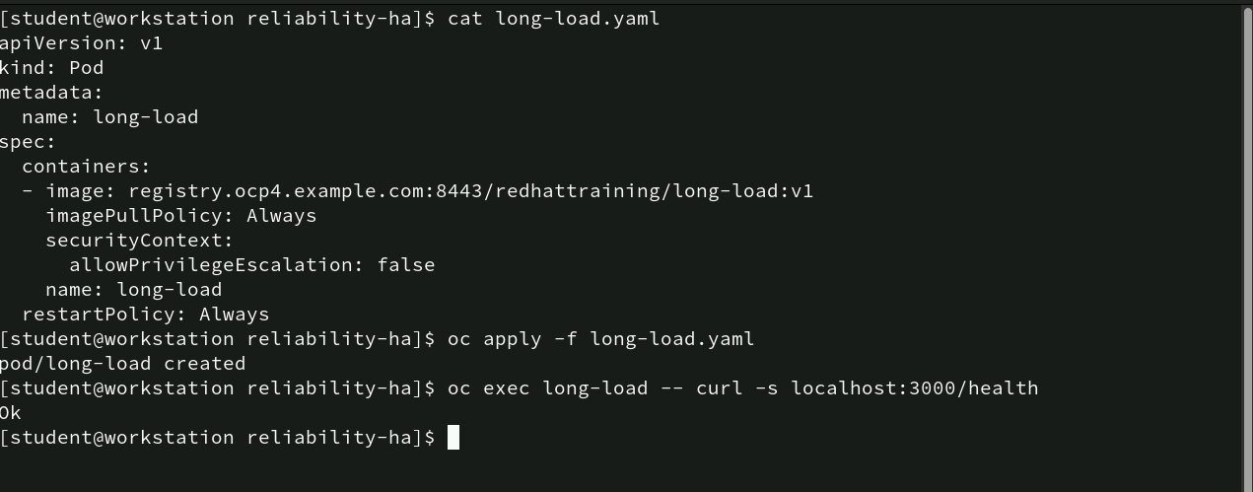
Deploying and verifying a Pod in OpenShift
cat long-load.yaml: Displays the contents of the long-load.yaml file, which defines a pod configuration.
oc apply -f long-load.yaml: This command tells OpenShift to apply the configuration specified in long-load.yaml. It creates or updates the pod based on the provided settings.
oc exec long-load -- curl -s localhost:3000/health:
• oc exec: Executes a command inside a running pod. Here, it targets the long-load pod.
• --: This signifies the end of oc exec options and the beginning of the command to be executed within the pod.
• curl -s localhost:3000/health: The curl command checks the health of a service running inside the pod on port 3000 with the /health endpoint. The -s option makes curl run in “silent” mode, suppressing extra output and showing only the response (“OK”).

Slide 14
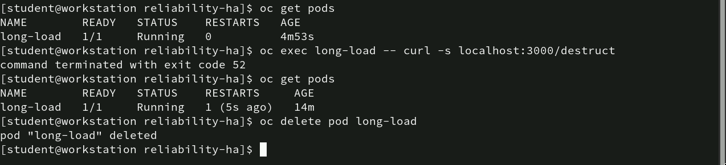
Managing and deleting Pod in OpenShift
oc get pods: This command lists all the pods currently running in the OpenShift cluster.
oc exec long-load -- curl -s localhost:3000/destruct: Runs a curl request to the /destruct endpoint inside the pod. The -s flag makes curl run silently. The command terminated with exit code 52, indicating that the /destruct endpoint might not be accessible or performed an unexpected operation that led to termination.
oc delete pod long-load: Deletes the long-load pod from the OpenShift cluster. The confirmation “pod ‘long-load’ deleted” indicates the pod was successfully removed.

Slide 15
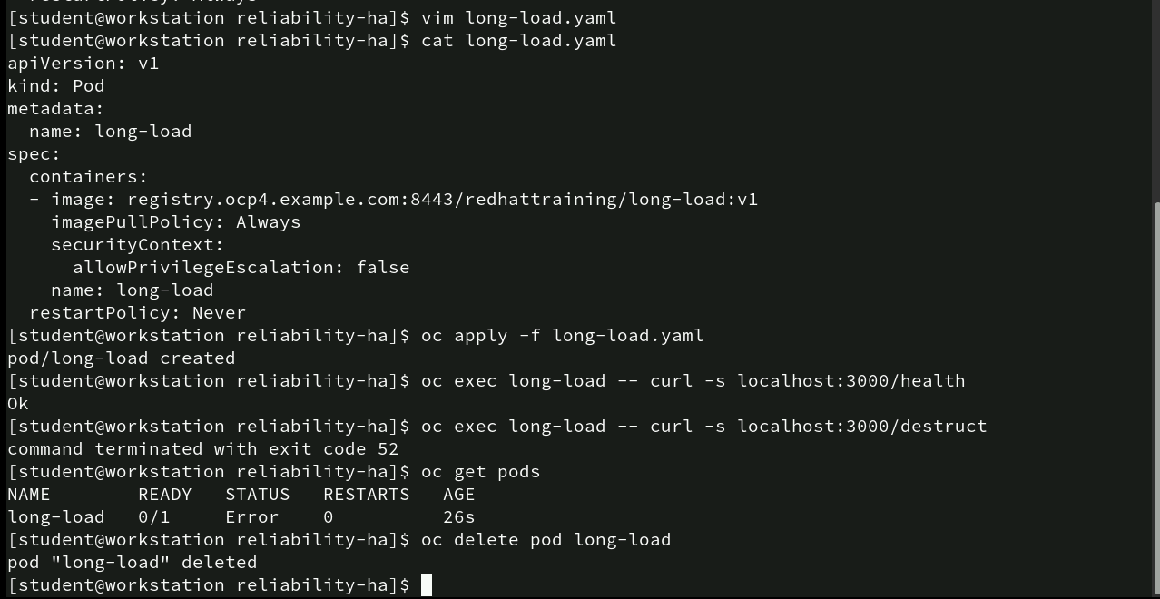
Modifying, Deploying and managing Pod
vim long-load.yaml: Opens the long-load.yaml file in the vim text editor, allowing to modify the pod configuration.
cat long-load.yaml: Displays the modified contents of the long-load.yaml file. The key modification is restartPolicy: Never, meaning the pod will not restart automatically if it fails. Other details, such as the image location, imagePullPolicy: Always, and allowPrivilegeEscalation: false under securityContext, remain unchanged.
oc apply -f long-load.yaml: Applies the updated configuration to the cluster, creating the pod with the modified restart policy. The message “pod/long-load created” confirms the pod’s creation.

Slide 16
Modifying, Deploying and managing Pod
oc exec long-load -- curl -s localhost:3000/health: Executes a curl command inside the long-load pod to check the /health endpoint. The response “OK” confirms the service within the pod is functioning correctly.
oc exec long-load -- curl -s localhost:3000/destruct: Runs another curl command targeting the /destruct endpoint, which results in the command terminating with exit code 52, indicating an issue or deliberate termination.
oc get pods: Lists the current pod status.
oc delete pod long-load: Deletes the long-load pod, with the message “pod ‘long-load’ deleted” confirming its successful removal from the cluster.

Slide 17
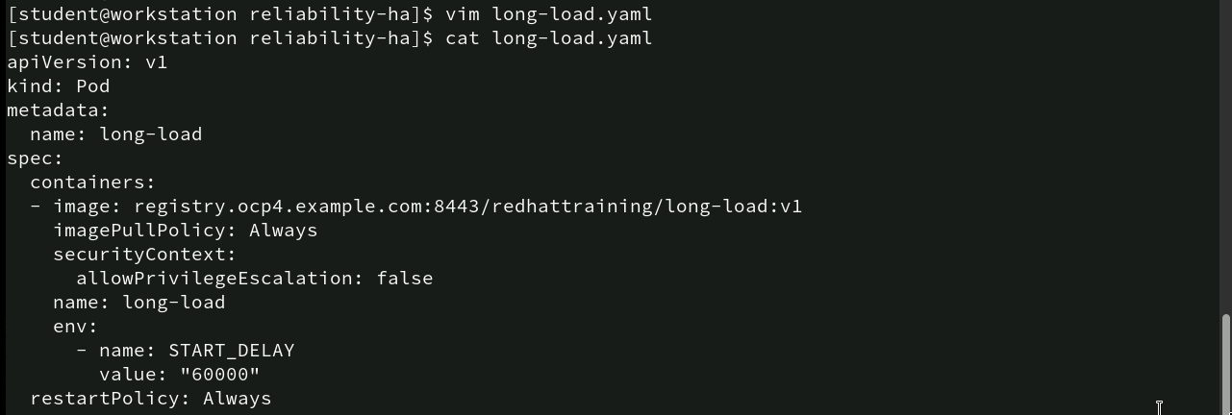
Modifying pod Configuration with Env Variables
- vim long-load.yaml: Opens the long-load.yaml file in the vim editor, allowing modifications to the pod’s configuration.
- cat long-load.yaml: Displays the updated contents of the long-load.yaml file. The main additions and settings are as follows:
• apiVersion: v1, kind: Pod – Defines a pod resource.
• metadata: Pod named long-load.
• spec:
containers: Uses image registry.ocp4.example.com:8443/redhattraining/long-load:v1.
imagePullPolicy: Always – Always pulls the container image.
securityContext: allowPrivilegeEscalation: false – Prevents elevated privileges.
env: START_DELAY set to 60000 (60 seconds), likely controls startup delay.
restartPolicy: Always – Pod restarts on failure for high availability.

Slide 18
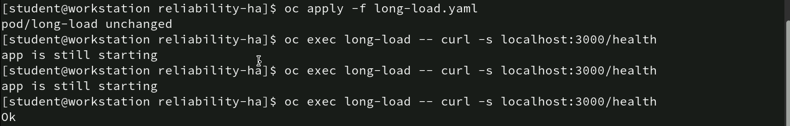
Applying Changes and Monitoring Pod Health Status
oc apply -f long-load.yaml: This command reapplies the long-load.yaml configuration file to the cluster. The message “pod/long-load unchanged” indicates that the pod’s configuration was already up-to-date, and no changes were necessary.
oc exec long-load -- curl -s localhost:3000/health (executed multiple times):This command checks the health status of the long-load pod’s application by accessing the /health endpoint inside the pod.
• The first two attempts return the message “app is still starting,” indicating that the application within the pod is still initializing and not yet ready to respond fully, likely due to the START_DELAY environment variable set earlier.
• On the third attempt, the command finally returns “OK,” confirming that the application has completed its startup process and is now running correctly within the pod.

Slide 19
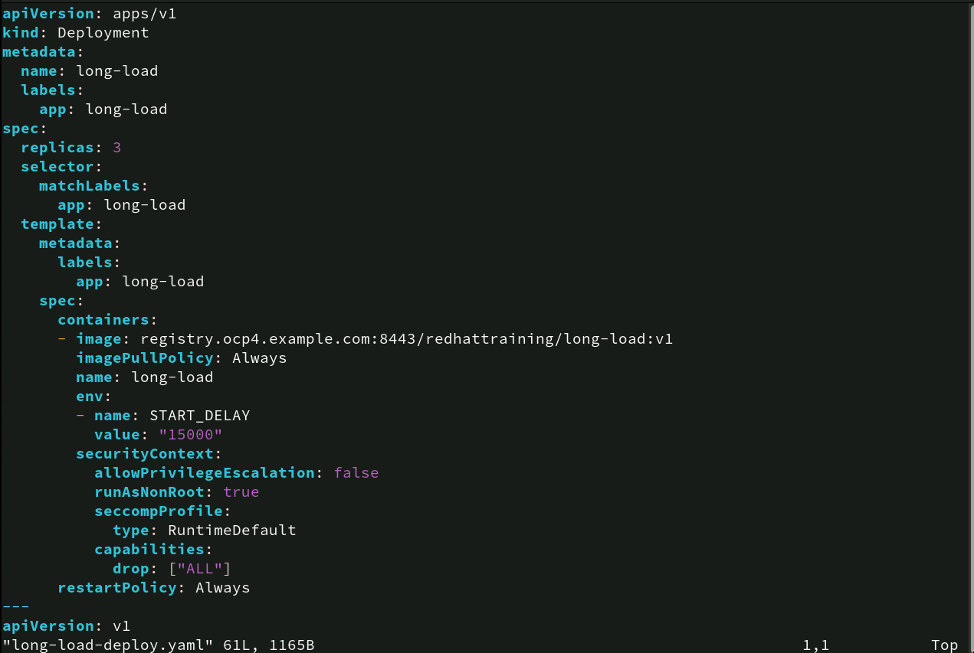
Defining Kubernetes Deployment for a Multi-Replica Pod
apiVersion: apps/v1, kind: Deployment – Defines a Kubernetes Deployment resource for managing multiple replicas.
metadata:
- name: long-load – Sets the deployment name.
- labels: app: long-load – Assigns a label for identification.
spec:
- replicas: 3 – Creates and manages three replicas of the pod.
- selector: matchLabels: app: long-load – Targets pods with the label app: long-load.

Slide 20
Defining Kubernetes Deployment for a Multi-Replica Pod
template:
- metadata/labels: Labels pods as app: long-load.
- spec:
- containers: Uses image registry.ocp4.example.com:8443/redhattraining/long-load:v1.
- imagePullPolicy: Always – Always pulls the image.
- env: START_DELAY: “15000” – Introduces a 15-second startup delay.
- securityContext:
- allowPrivilegeEscalation: false – Prevents privilege escalation.
- runAsNonRoot: true – Ensures non-root user execution.
- seccompProfile: RuntimeDefault – Sets a default security profile.
- capabilities drop: [“ALL”] – Removes all Linux capabilities.
- restartPolicy: Always – Pods restart on failure.

Slide 21
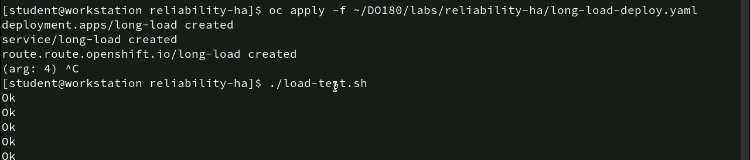
Applying Deployment Configuration and Perform Load testing
oc apply -f ~/DO180/labs/reliability-ha/long-load-deploy.yaml: This command applies the long-load-deploy.yaml file, deploying the long-load application with its necessary components. The successful creation of the deployment.apps/long-load, service/long-load, and route.route.openshift.io/long-load indicates that the deployment, service, and route are all set up in OpenShift.
./load-test.sh: This command executes a load-testing script named load-test.sh. The repeated “Ok” outputs indicate that the load test was successfully sending requests to the application, and the application responded correctly to each request.

Slide 22
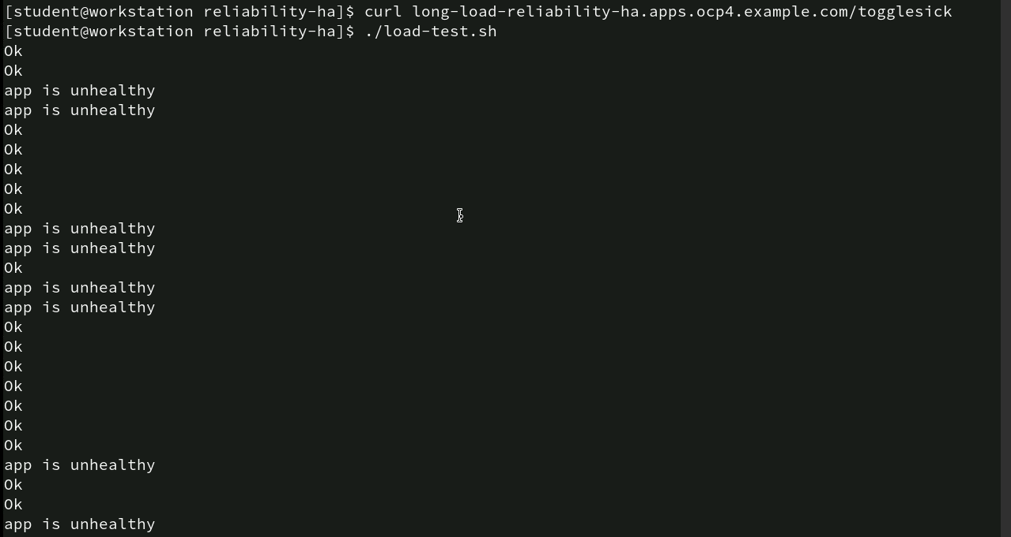
Monitoring Application Health During Load Testing
curl long-load-reliability-ha.apps.ocp4.example.com/togglesick: This command sends a request to the togglesick endpoint of the long-load-reliability-ha application, toggling the application’s health status between healthy and unhealthy states for testing purposes.
./load-test.sh: Executes the load-test.sh script, which repeatedly sends requests to the application to monitor its health and performance. The output shows a series of “Ok” responses, indicating that the application was responding correctly to the load at those times. Periodically, the output shows “app is unhealthy,” suggesting that the application experienced moments of simulated or real failure in response to the toggling initiated earlier.

Slide 23
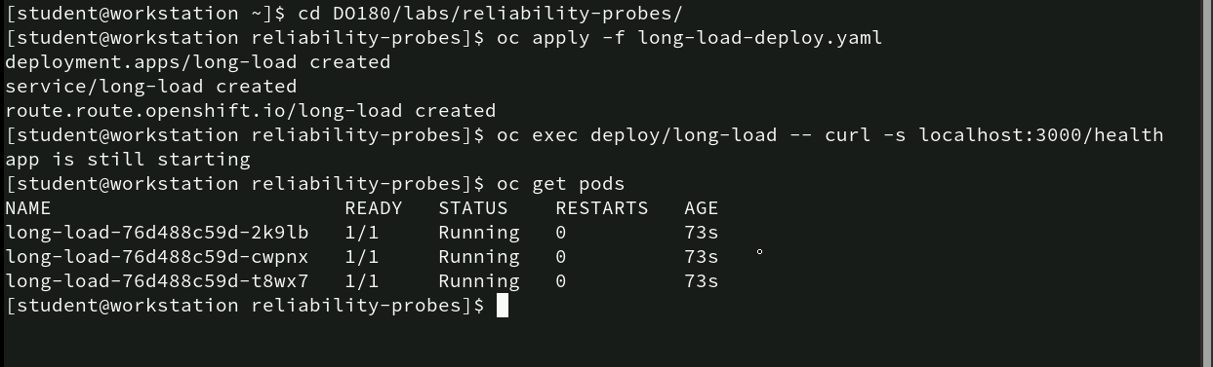
Deploying with Reliability Probes and Monitoring Pod status
cd DO180/labs/reliability-probes/: Changes the directory to the reliability-probes folder.
oc apply -f long-load-deploy.yaml: Applies the long-load-deploy.yaml file to deploy the application. The output confirms the creation of the deployment (deployment.apps/long-load created), service (service/long-load created), and route (route.route.openshift.io/long-load created).
oc exec deploy/long-load -- curl -s localhost:3000/health: Executes a curl request within the long-load deployment to check the health endpoint at /health. The response “app is still starting” indicates that the application is in the initialization phase and not yet fully ready.
oc get pods: Lists the pods managed by the deployment.

Slide 24
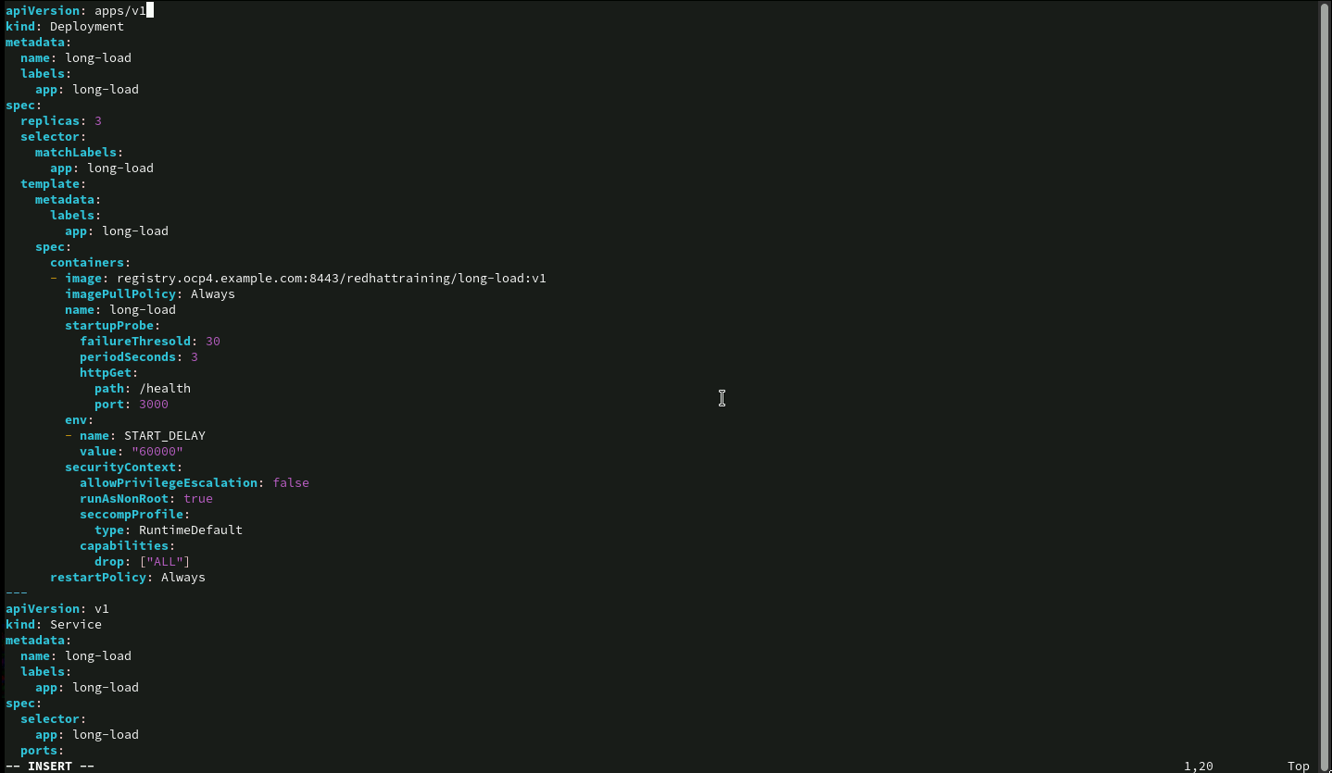
Configuring a Deployment with Startup Probes in Openshift
• startupProbe:
failureThreshold: 30: The probe will try up to 30 times before marking the container as unhealthy.
periodSeconds: 3: The probe checks every 3 seconds.
httpGet: Defines the probe’s check via HTTP at the path /health on port 3000.
• env: Sets the environment variable START_DELAY with a value of "60000" (60 seconds) to control the container’s startup delay.

Slide 25
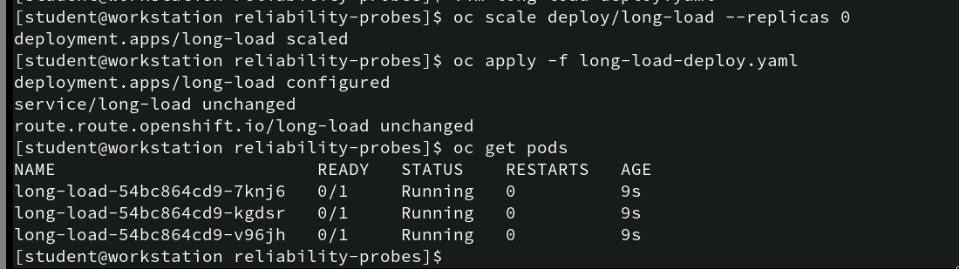
Scaling and reapplying a deployment in Openshift
oc scale deploy/long-load --replicas 0: This command scales down the long-load deployment to 0 replicas, effectively stopping all running pods managed by this deployment.
oc apply -f long-load-deploy.yaml: Reapplies the long-load-deploy.yaml configuration.
oc get pods: Displays the status of the pods after reapplying the deployment configuration. The list shows three pods (long-load-54bc864cd9-7knj6, long-load-54bc864cd9-kgdsr, and long-load-54bc864cd9-v96jh) in a “Running” state, but with READY as 0/1.

Slide 26
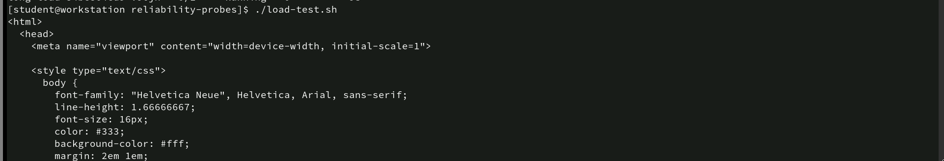
Executing Load Testing and Observing HTML Response
- ./load-test.sh: This command runs the load-test.sh script to test the application’s ability to handle multiple requests. The output displayed is an HTML snippet

Slide 27
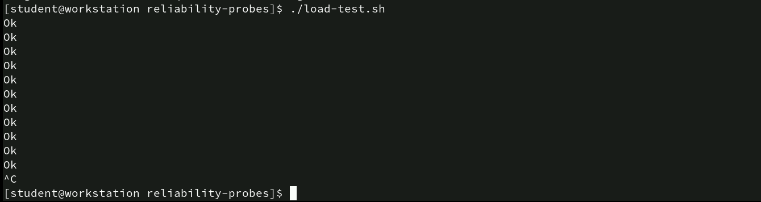
Verifying Application Stability with Load testing
- ./load-test.sh: This command executes the load-test.sh script to simulate multiple requests to the deployed application, testing its ability to handle the load.
The repeated “Ok” responses indicate that each request sent by the script was successfully processed by the application, suggesting that it is responding correctly and consistently under load.

Slide 28
Executing Health Toggle Command
- oc exec deploy/long-load -- curl -s localhost:3000/togglesick:
• oc exec: Executes a command inside one of the pods belonging to the long-load deployment.
• -- curl -s localhost:3000/togglesick: Runs a curl command to access the /togglesick endpoint on port 3000 inside the pod.
This action toggles the health status of the application between “healthy” and “unhealthy,” simulating a change in state for testing purposes. This endpoint (/togglesick) is typically used in testing scenarios to verify how the deployment responds when an application becomes unhealthy, ensuring that the configured probes, alerts, or restart mechanisms in the deployment react correctly to such changes.

Slide 29
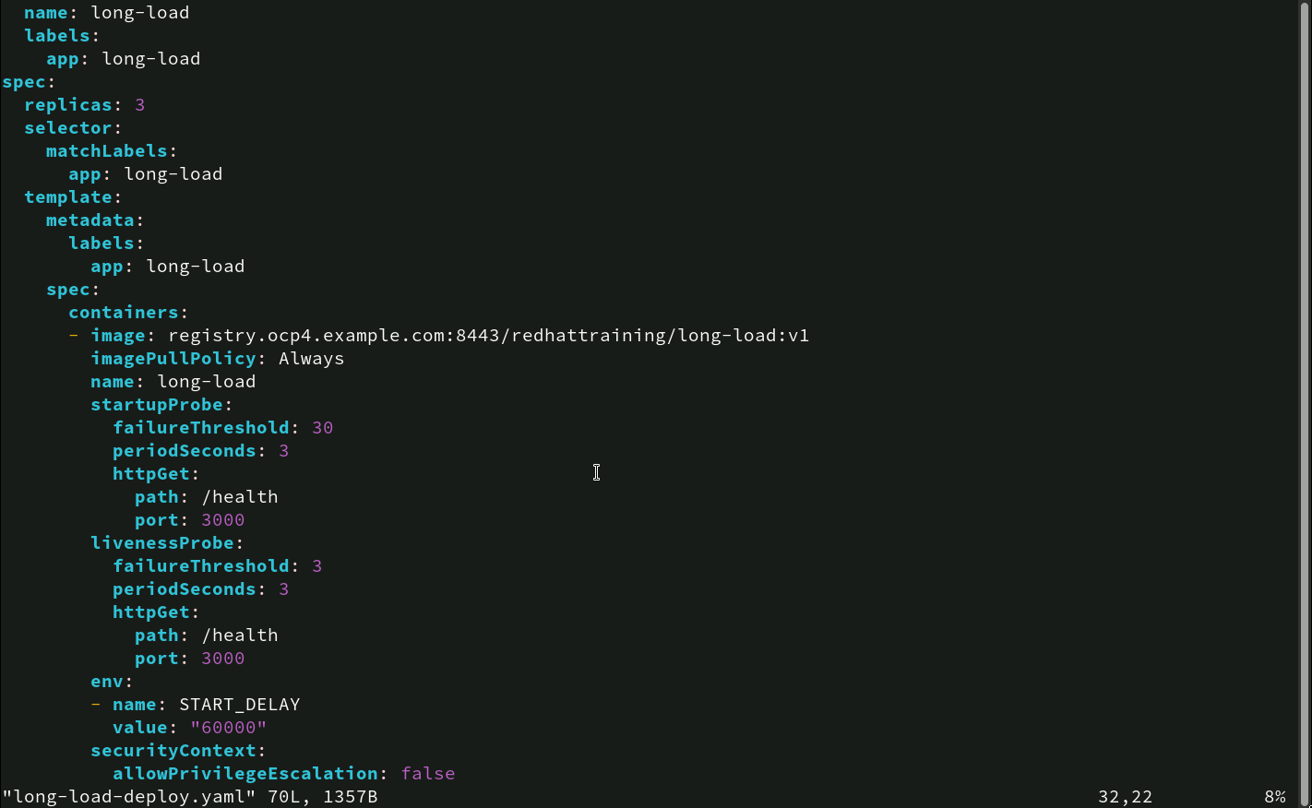
Deployment Configuration with Liveness Probes
• failureThreshold: 3: This means that if the probe fails 3 consecutive times, the container is considered unhealthy. A lower threshold means the container will be restarted more quickly after an issue is detected.
• periodSeconds: 3: The probe checks the /health endpoint every 3 seconds, providing frequent monitoring. This frequent interval ensures quick detection of any potential issues with the container’s operation.
• httpGet: The probe uses an HTTP GET request to access the /health path on port 3000. If this endpoint doesn’t return a successful status code (2xx), it’s considered a failed check.

Slide 30
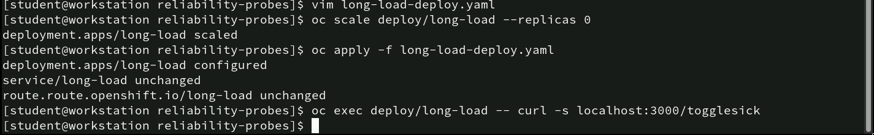
Scaling, Configuring and Toggling Health Status
vim long-load-deploy.yaml: Opens the long-load-deploy.yaml file in the vim editor for modifications, allowing changes to be made to the deployment configuration.
oc scale deploy/long-load --replicas 0: Scales down the long-load deployment to 0 replicas, effectively terminating all running pods managed by this deployment.
oc apply -f long-load-deploy.yaml: Reapplies the configuration from the long-load-deploy.yaml file:
oc exec deploy/long-load -- curl -s localhost:3000/togglesick: Executes a curl command inside the deployment long-load to access the /togglesick endpoint on port 3000. This toggles the health status of the application, simulating an unhealthy state for testing purposes.

Slide 31
Command for recreating MySQL Deployment with persistent storage
• ./load-test.sh: Executes the load-test.sh script, which sends multiple requests to the deployed application to evaluate its handling capacity.
The application’s response starts with HTML content, indicating that the tested endpoint is serving a web page.

Slide 32
Command for recreating MySQL Deployment with persistent storage
The screenshot shows multiple “Ok” responses generated by a running load test script (./load-test.sh).
Each “Ok” indicates that the application successfully handled a request and responded correctly, demonstrating its ability to manage the load without any errors or delays.

Slide 33
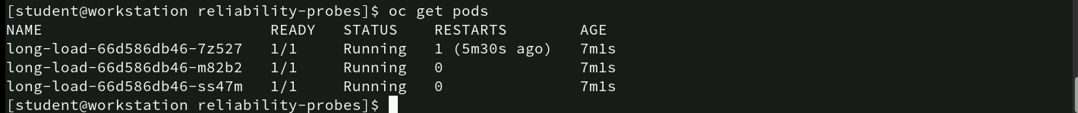
Checking the status of the pods
oc get pods: This command lists the current pods running under the deployment.
• Pod Details:
• There are three pods (long-load-66d586db46-7z527, long-load-66d586db46-m82b2, long-load-66d586db46-ss47m) associated with the long-load deployment.
• READY: All pods show 1/1, indicating that they are fully ready to handle traffic or requests.
• STATUS: All pods are in the “Running” state, meaning they are active and operational.
• RESTARTS:
• The first pod (long-load-66d586db46-7z527) has restarted once, approximately 5 minutes and 30 seconds ago, likely due to a failure detected by a liveness or readiness probe.
• The other two pods have 0 restarts, indicating they have been running without any interruptions.
• AGE: All pods are about 7m 1s old, indicating they were started around the same time.

Slide 34
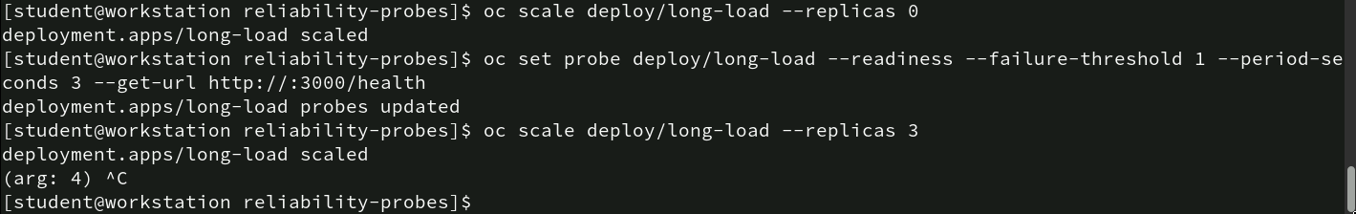
Scaling and Configuring Readiness Probes
oc scale deploy/long-load --replicas 0: Scales the long-load deployment down to 0 replicas, effectively stopping all running pods. This is a common practice when updating or reconfiguring a deployment without causing interruptions.
oc set probe deploy/long-load --readiness --failure-threshold 1 --period-seconds 3 --get-url http://:3000/health: This command sets or updates the readiness probe for the long-load deployment.
• --readiness: Specifies that this probe monitors when the pod is ready to receive traffic.
• --failure-threshold 1: meaning the probe will consider the pod unready after a single failed check.
• --period-seconds 3: Configures the probe to check the pod’s health every 3 seconds.
• --get-url http://:3000/health: checks the /health endpoint on port 3000 to determine the readiness state.
- oc scale deploy/long-load --replicas 3: Scales the deployment back up to 3 replicas, starting three instances of the long-load pods to resume normal operation.

Slide 35
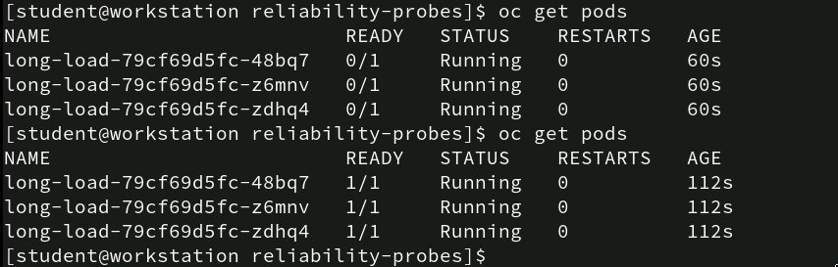
Observing Pod Readiness and Status Updates
oc get pods: command was run twice to monitor the “long-load” deployment:
• First Output: Three pods displayed (0/1 READY, STATUS “Running,” all running for 60s but not fully ready).
• Second Output: Same pods now show 1/1 READY, STATUS “Running,” no restarts, and active for 112s, indicating they passed readiness probes.

Slide 36
Simulating Application Hiccup for Testing
• oc exec deploy/long-load -- curl -s localhost:3000/hiccup?time=5:
• oc exec deploy/long-load: Executes a command inside one of the pods managed by the long-load deployment.
• curl -s localhost:3000/hiccup?time=5: Sends a curl request to the /hiccup endpoint on port 3000 with a query parameter time=5. This command likely a temporary issue or delay (“hiccup”) in the application for 5 seconds.

Slide 37
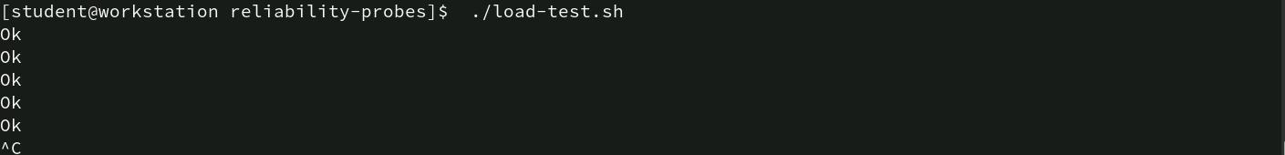
Running Load test to verify
• ./load-test.sh: Executes the load-test.sh script, which sends multiple requests to the application to test its responsiveness and stability under load.
• The repeated “Ok” responses indicate that the application successfully processed each request, confirming that it is functioning correctly and maintaining stability during the load test.

Slide 38
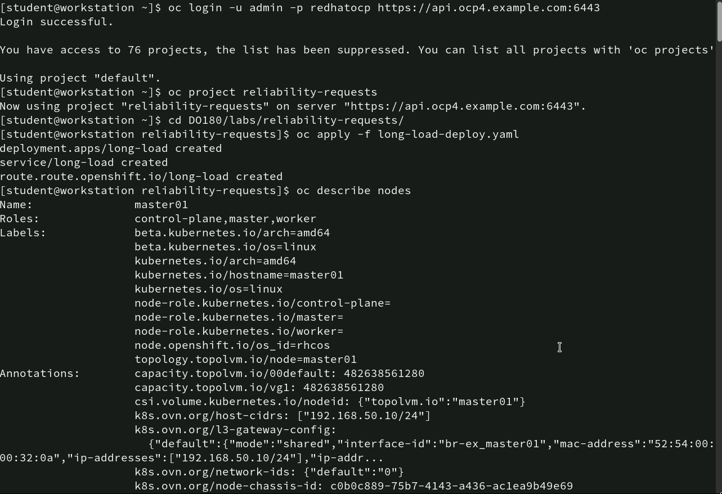
Describing Node Detailss
The oc describe nodes command shows details about the “master01” node:
• Roles: Acts as control-plane, master, and worker.
• Labels: Indicates attributes like architecture (amd64), OS (linux), and its roles.
• Annotations: Includes information on capacity, volume, network configurations, and chassis ID.

Slide 39
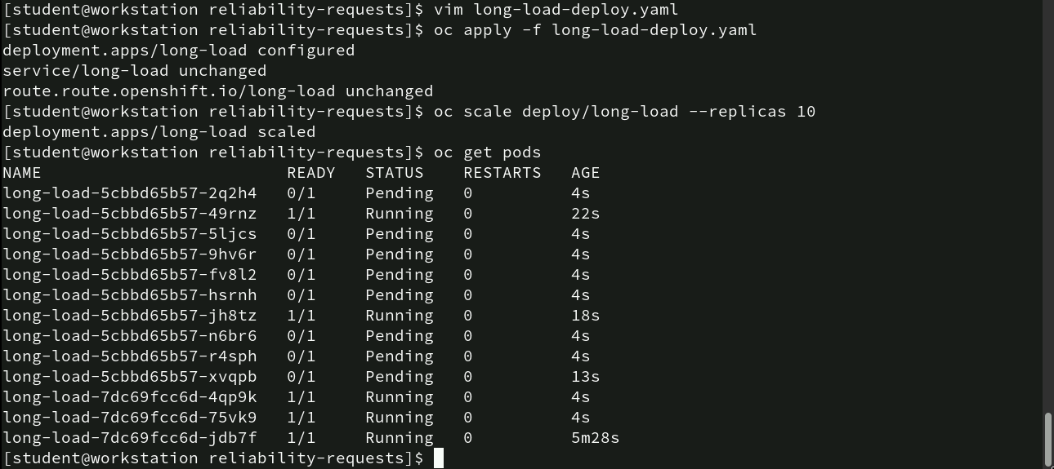
Scaling Deployment and Monitoring Pod Status
- vim long-load-deploy.yaml: Opens the deployment file for editing.
- oc apply -f long-load-deploy.yaml: Updates the deployment; confirms deployment change, with service and route remaining unchanged.
- oc scale deploy/long-load --replicas 10: Scales the deployment to 10 replicas; confirmed by "deployment.apps/long-load scaled."
- oc get pods: Shows pod status; several pods are "Pending" (0/1 READY), some are "Running" but not fully ready, and one pod has been running for 5m28s.

Slide 40
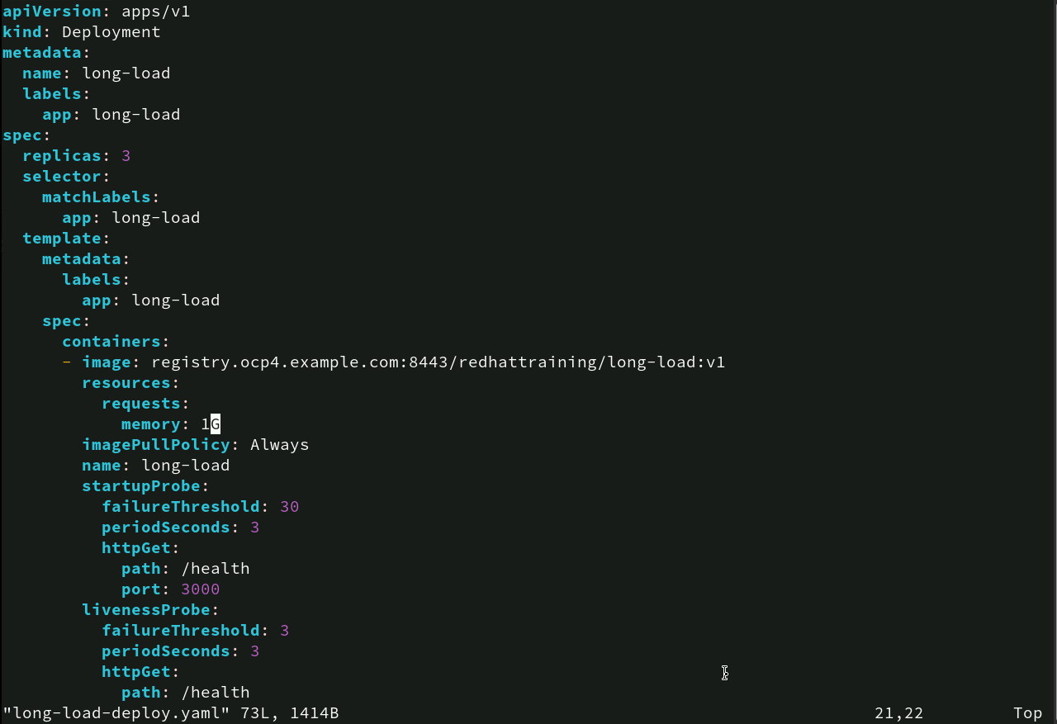
Deployment Configuration with Resources Requests and Probes
• apiVersion & kind: Defines a Deployment named “long-load” using apps/v1.
• metadata: Name is “long-load” with label app: long-load.
• spec:
• replicas: 3 for high availability.
• selector/template: Labels pods as app: long-load.
• containers:Uses image registry.ocp4.example.com:8443/redhattraining/long-load:v1.
• resources: Requests 1GB memory.
• imagePullPolicy: Always pulls the latest image.
• startupProbe: Allows 30 failures, checks every 3s at /health on port 3000.
• livenessProbe: Similar, with 3 failures allowed every 3s for ongoing health checks.

Slide 41
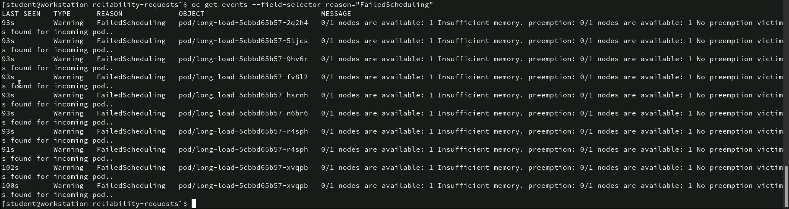
Analyzing FailedScheduling Due to Insufficient Memory
- oc get events --field-selector reason="FailedScheduling" retrieves pod scheduling failures filtered by the “FailedScheduling” reason.
• Event Details:
• LAST SEEN: Time since the failure (e.g., 93s, 100s).
• TYPE: Warning, indicating an issue.
• REASON: Pods failed scheduling.
• OBJECT: Affected pods (e.g., long-load-5cbbd65b57-2q2h4).
• MESSAGE: “0/1 nodes available: 1 Insufficient memory, no preemption victim” means the single node lacks memory, and no pods can be evicted to free up space.

Slide 42
Describing Pod details
oc describe pod/long-load-5cbbd65b57-2q2h4: This command provides detailed information about the specified pod (long-load-5cbbd65b57-2q2h4).
• Output Information:
• Name: long-load-5cbbd65b57-2q2h4: The full name of the pod.
• Namespace: reliability-requests: Indicates that this pod belongs to the reliability-requests project/namespace.
• Priority: 0: This shows that the pod has a default priority level, meaning it will not preempt other pods with higher priority in case of resource contention.
• Service Account: default: The pod is using the default service account, which is a Kubernetes account that the pod uses for accessing the Kubernetes API.

Slide 43
Describing Pod details
• Event Summary:
- Type: Warning - Indicates an issue with pod scheduling.
- Reason: FailedScheduling - Pod couldn’t be scheduled on a node.
- Age: 2m50s - Happened about 2 minutes and 50 seconds ago.
- From: default-scheduler - Scheduler attempted to place the pod.
- Message: “0/1 nodes available: 1 Insufficient memory, no preemption victims” - The single node lacks memory, and no lower-priority pods could be evicted to free up resources.

Slide 44
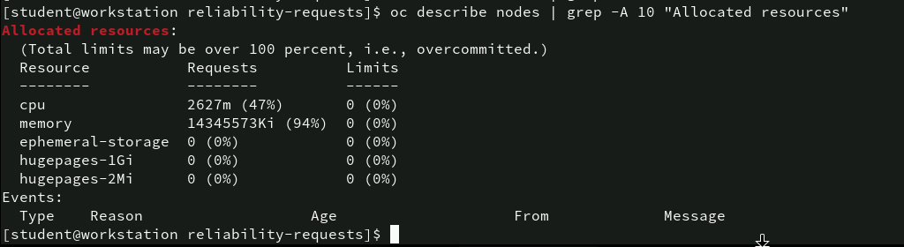
Reviewing Allocated Resources on the Node
oc describe nodes | grep -A 10 "Allocated resources”: retrieves and shows the next 10 lines of allocated resource details for the node.
Analysis:
Memory is highly utilized (94%), causing pod scheduling issues. Solutions include:
• Reducing memory requests of existing pods.
• Adding more nodes to distribute load.
• Optimizing application resource usage to free memory.

Slide 45
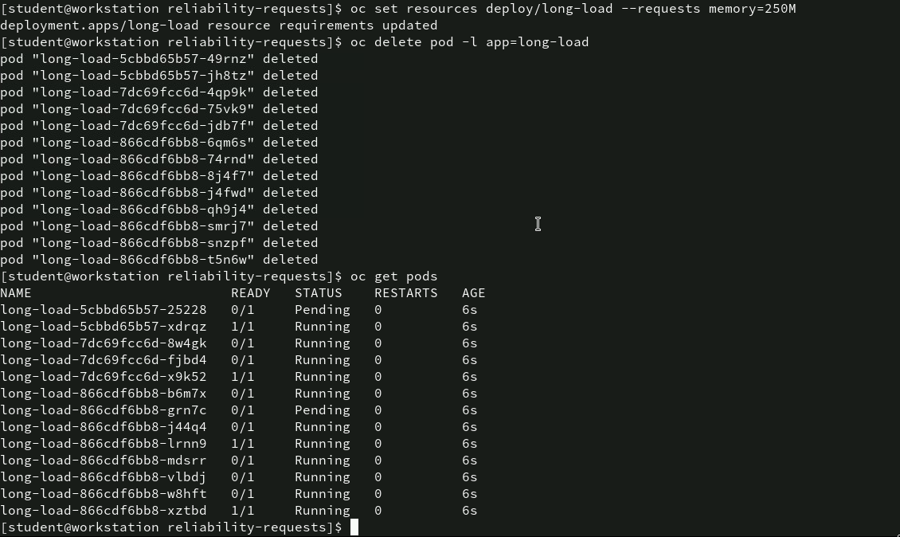
Adjusting Resource Requests and Redeploying pods
oc set resources deploy/long-load --requests memory=250M: Updates the long-load deployment to reduce memory requests to 250 MiB, making it easier to schedule pods on available nodes.
oc delete pod -l app=long-load: Deletes all existing long-load pods, allowing Kubernetes to recreate them with the updated resource settings.
oc get pods: Shows the current state of pods.
Analysis
Reducing the memory request to 250 MiB allowed more pods to be scheduled successfully, resolving previous “Insufficient memory” issues.

Slide 46
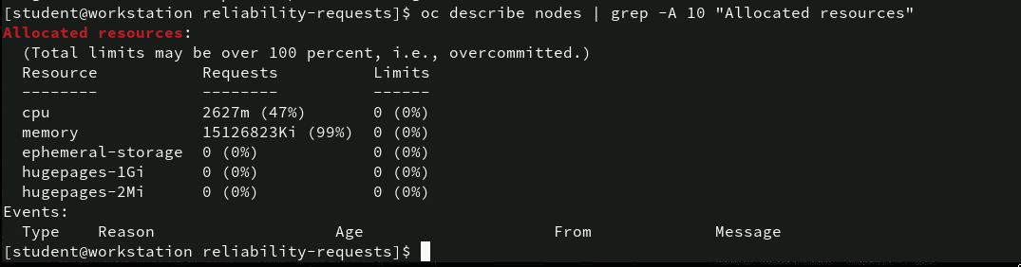
Updated Node Resource Allocation
- oc describe nodes | grep -A 10 "Allocated resources" shows the current resource allocation.
Analysis
Although reducing the pod memory requests allowed more pods to start, the node’s memory is now nearly fully utilized (99%), indicating potential risk of resource exhaustion. Adding more nodes or further optimizing memory usage might be needed.

Slide 47
Editing Deployment Configuration
oc project reliability-limits: Switches to the reliability-limits project in OpenShift, confirming that the user is now working within this project.
vim ~/DO180/labs/reliability-limits/leakapp.yml: Opens the leakapp.yml file in the vim editor, allowing for edits to the deployment configuration related to the leakapp application.
This process sets the stage for modifying or deploying resources within the reliability-limits project.

Slide 48
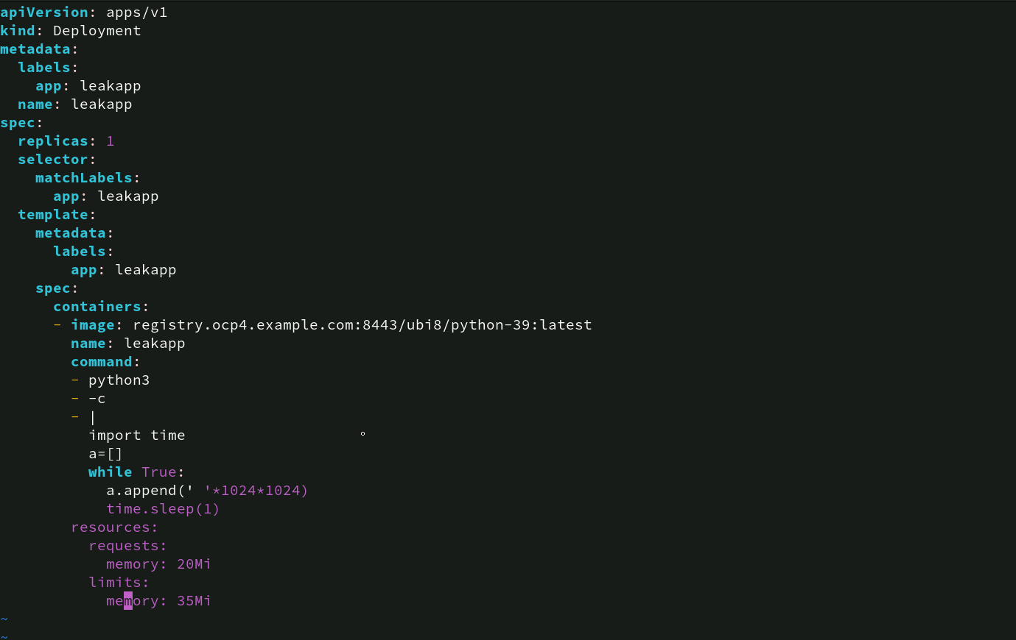
Deployment Configuration for leakapp with Resource limits
• Deployment: Creates a single leakapp pod using the python-39 image.
• Script: Executes a Python loop that continuously appends 1MB data to a list every second, simulating a memory leak.
• Resources:
• requests: 20Mi - Reserves 20 MiB of memory.
• limits: 35Mi - Caps memory usage at 35 MiB.
This setup tests how Kubernetes handles the pod as it approaches its memory limit.

Slide 49
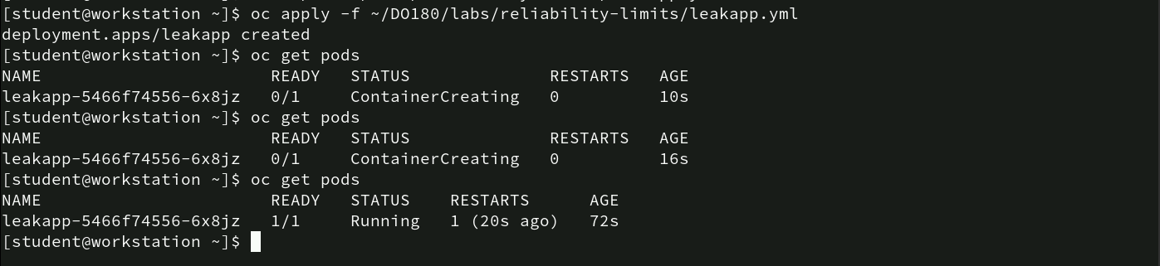
Deploying and Monitoring Leakapp Pod Status
oc apply -f ~/DO180/labs/reliability-limits/leakapp.yml: Deploys the leakapp application as per the configuration file.
oc get pods: Initially shows the pod leakapp-5466f74556-6x8jz in the ContainerCreating state, indicating the container is starting up. After some time, the pod transitions to Running with 1/1 readiness, meaning it’s fully operational. RESTARTS column shows 1, indicating the pod restarted once, likely due to hitting its memory limit.
Analysis
The leakapp pod started correctly but experienced a restart, validating that Kubernetes enforced the defined memory limits.

Slide 50
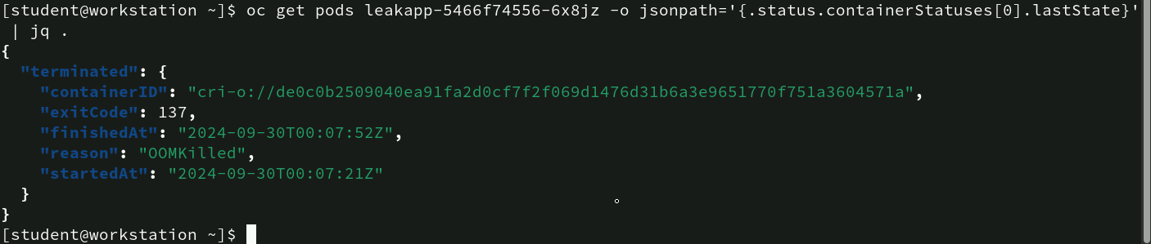
Analyzing Pod termination Details
oc get pods leakapp-5466f74556-6x8jz -o jsonpath='{.status.containerStatuses[0].lastState}' | jq . :
This retrieves the last state of the leakapp pod in JSON format for detailed inspection.
• Output Details:
• “exitCode”: 137: Exit code 137 signifies the container was killed due to exceeding its memory limit.
• “reason”: “OOMKilled”: Confirms the termination was caused by an “Out of Memory” (OOM) condition.
Analysis
The pod was terminated due to memory overconsumption, validating that Kubernetes enforced the memory: 35Mi limit set in the deployment configuration.

Slide 51
Observing Pod details
• Command: oc get pods displays the current state of the leakapp pod.
• Pod Status:
• STATUS: CrashLoopBackOff indicates the pod is repeatedly crashing and restarting.
• RESTARTS: 3 - The pod has restarted three times.
• AGE: 3m50s - The pod has been running for nearly 4 minutes.
Analysis
The CrashLoopBackOff status shows that the pod keeps exceeding its memory limit and is being terminated repeatedly, suggesting the leakapp is persistently breaching its defined memory cap of 35Mi. Adjusting the memory limit or fixing the memory leak in the application is necessary to resolve this.

Slide 52
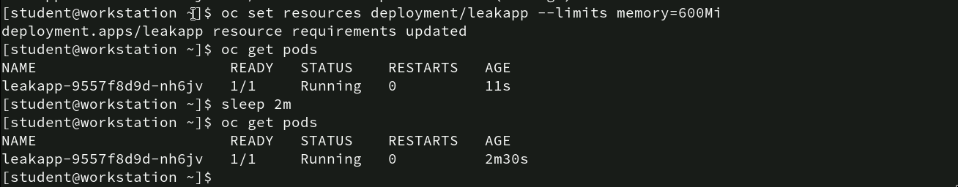
Increasing Memory Limits for Leakapp Pod
oc set resources deployment/leakapp --limits memory=600Mi: increased the memory limit to 600 MiB, updating the resource requirements for leakapp.
oc get pods: shows the pod leakapp-9557f8d9d-nh6jv in a Running state with 0 restarts, indicating stability. After 2 Minutes (sleep 2m): The pod remains Running without restarts, suggesting that the increased memory limit is sufficient for the application’s needs.
Analysis
By raising the memory limit to 600 MiB, the leakapp pod stopped encountering OOM (Out of Memory) issues, confirming that the new limit accommodates its resource demands.

Slide 53
Monitoring Resource usage of leakapp Pod
- oc adm top pods: displays current resource usage for pods.
Analysis
The leakapp pod’s memory consumption is well below the updated 600 MiB limit, indicating the current configuration is stable and adequately meets the application’s memory requirements.

Slide 54
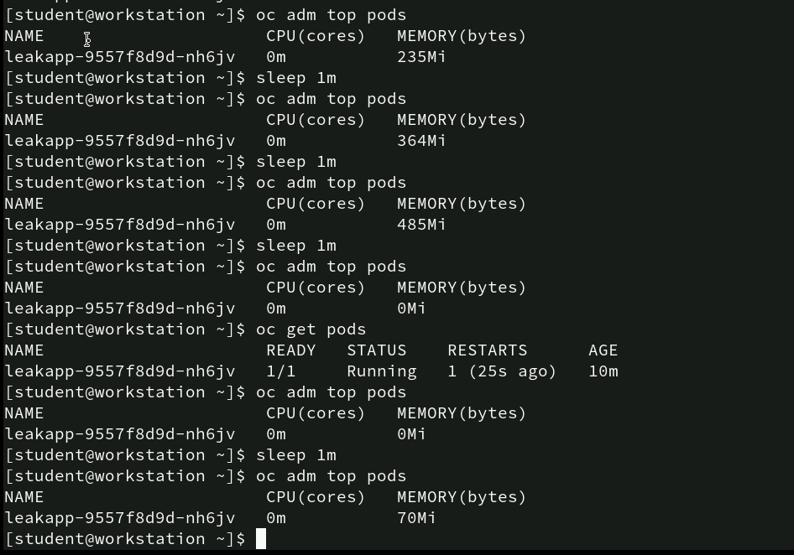
Monitoring Gradual memory Increase in leakapp Pod
Repeated oc adm top pods commands check memory usage at 1-minute intervals.
• Observations:
• Memory increased progressively from 235 MiB → 364 MiB → 485 MiB.
• At the 4th check, memory dropped to 0Mi, indicating the pod was restarted due to hitting its memory limit.
• Pod Status Check (oc get pods): The pod was running with 1 restart, confirming it was restarted due to exceeding memory.
• Final Memory Reading: The pod restarts and resumes with a reduced memory footprint at 70 MiB.
Analysis
The pod’s memory steadily increased until it exceeded the limit, causing a restart. After the restart, it operated with lower memory usage, demonstrating that Kubernetes effectively managed the resource limit.

Slide 55
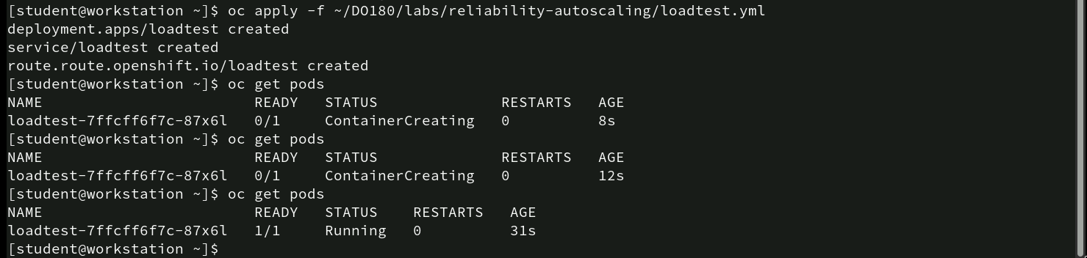
Deploying and monitoring loadtest Pod creation
- oc apply -f ~/DO180/labs/reliability-autoscaling/loadtest.yml : deploys the loadtest application.
• Pod Status (oc get pods):
• Initially, the pod loadtest-7ffcff6f7c-87x6l was in ContainerCreating status for about 12 seconds.
• After 31 seconds, it transitioned to Running status with 0 restarts.
Analysis
The loadtest pod deployed successfully, showing a typical initialization period before reaching a stable running state, indicating the deployment and container creation process worked as expected.

Slide 56
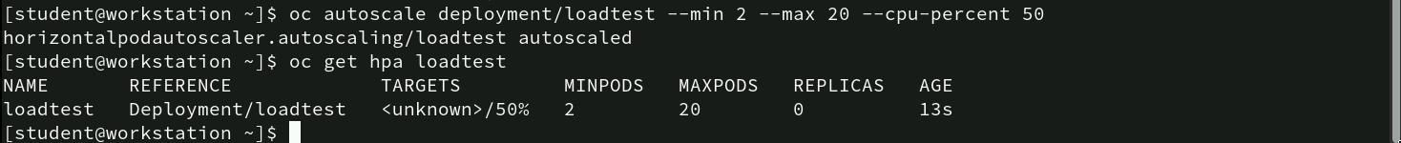
Setting up Autoscaling for the loadtest Deployment
oc autoscale deployment/loadtest --min 2 --max 20 --cpu-percent 50: Configures autoscaling for loadtest deployment, with a minimum of 2 pods and a maximum of 20, targeting 50% CPU utilization.
oc get hpa loadtest: Displays the Horizontal Pod Autoscaler (HPA) settings, showing the target CPU percentage and pod limits. Current REPLICAS count is 0, with MINPODS set to 2 and MAXPODS to 20.
Analysis
The loadtest deployment has been set for autoscaling, although it hasn’t yet scaled up since CPU usage is currently below the threshold. This setup will allow dynamic scaling based on real-time CPU demands.

Slide 57
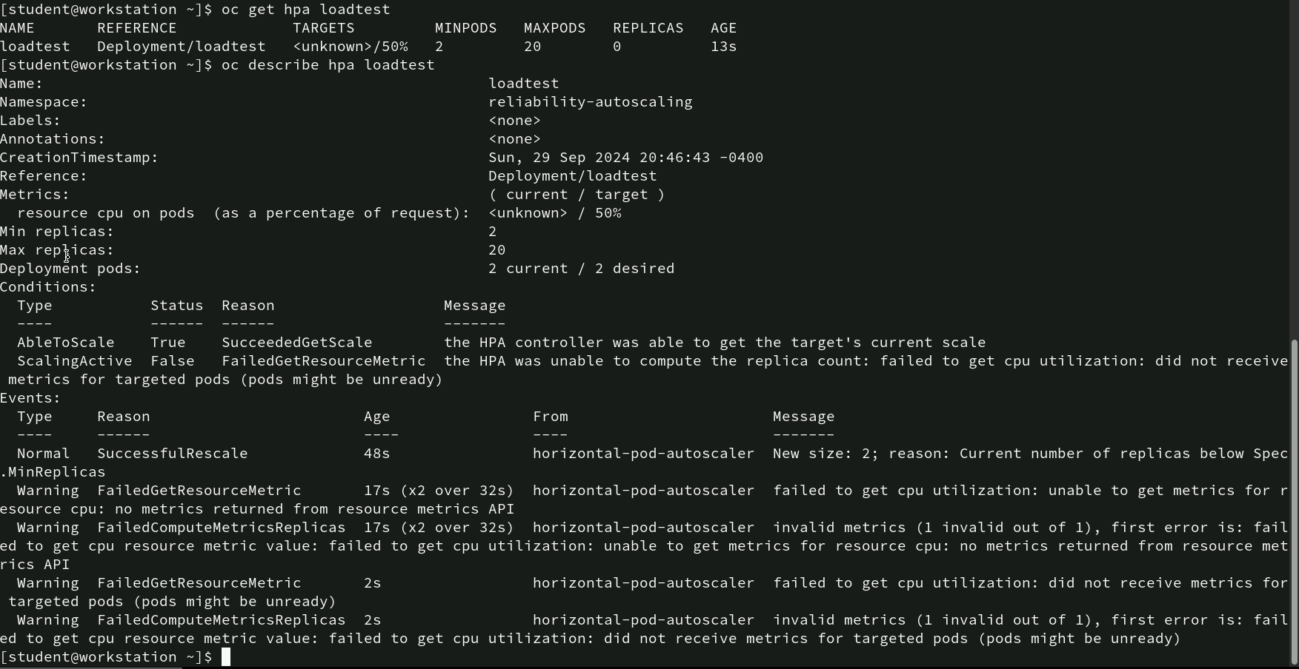
Analyzing HPA Status for loadtest Deployment
- oc describe hpa loadtest: Multiple warnings (FailedGetResourceMetric and FailedComputeMetricsReplicas) indicate that CPU metrics were not received for the targeted pods, suggesting that either the pods are not reporting metrics correctly, or there might be an issue with the metrics server.
Conclusion
The HPA is configured correctly but cannot function due to missing CPU utilization data. Check the metrics server setup or ensure that the pods are emitting the necessary metrics.

Slide 58
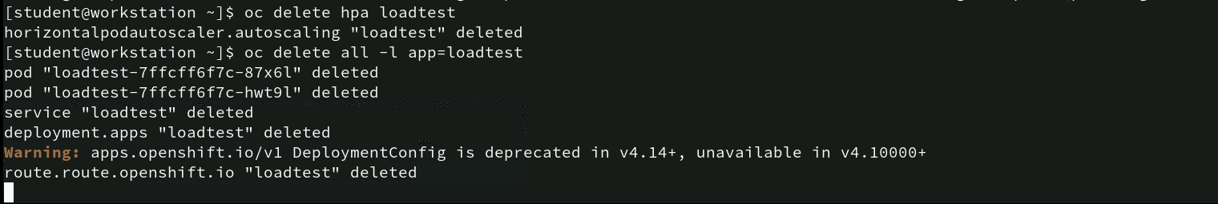
Deleting autoscaler and associated resources
oc delete hpa loadtest: Deletes the Horizontal Pod Autoscaler (HPA) named “loadtest,” which stops any further autoscaling for the associated deployment.
oc delete all -l app=loadtest: Deletes all resources associated with the label app=loadtest, including pods, services, deployments, and routes. This command ensures complete cleanup of all resources tied to the “loadtest” application.
Analysis
The commands effectively remove all resources related to the “loadtest” deployment and its autoscaling configuration. The warning serves as an important reminder to update older deployment configurations to newer standards, ensuring future compatibility.

Slide 59
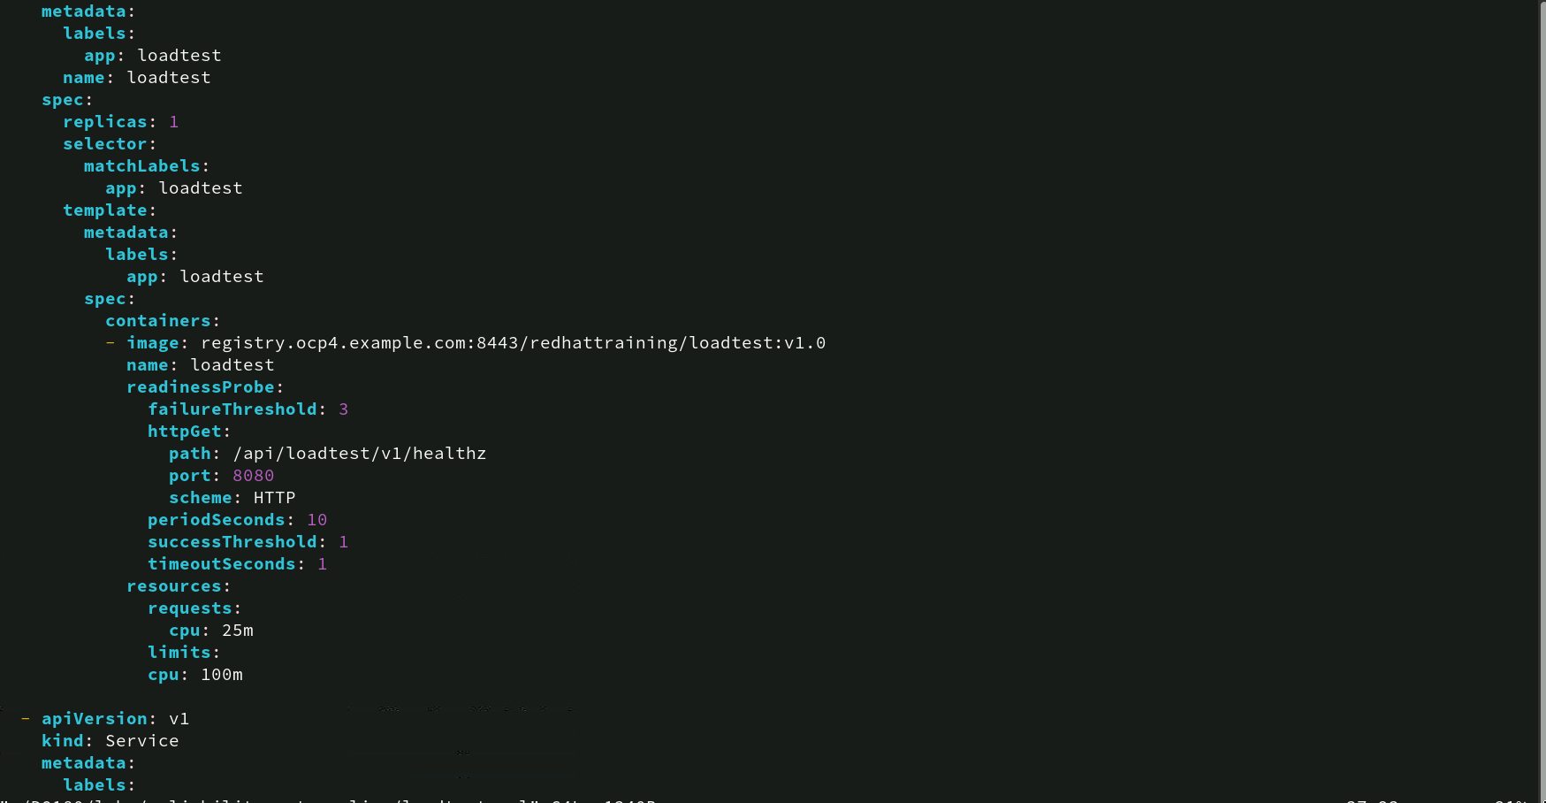
Loadtest Deployment configuration
- Readiness Probe: Monitors the endpoint /api/loadtest/v1/healthz on port 8080 using HTTP.
• Check interval: every 10 seconds.
• Failure threshold: 3 attempts before considering the container unhealthy.
• Success threshold: 1 successful check to mark as ready.
• Timeout for the probe: 1 second.
• Resource Requests and Limits:
• CPU Request: 25m (ensures minimum resources allocated).
• CPU Limit: 100m (maximum CPU the container can use).
This configuration ensures efficient monitoring and resource allocation for the “loadtest” application.

Slide 60
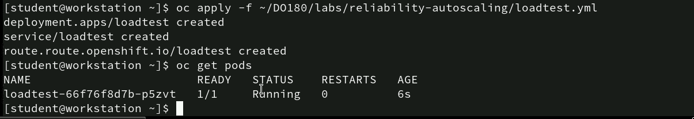
Deploying and verifying the Loadtest pod
oc apply -f ~/DO180/labs/reliability-autoscaling/loadtest.yml: This command applies the configuration from the loadtest.yml file, creating a deployment, service, and route for the loadtest application in OpenShift. It ensures the resources defined in the YAML file are instantiated within the cluster.
oc get pods: This command retrieves and displays the current status of the pods in the project. It shows that the loadtest pod is running with a status of 1/1, indicating it’s fully up, with no restarts, and has been active for 6 seconds.
Analysis: The commands indicate a successful deployment of the loadtest application, as the pod is running without issues. The prompt response and the running status confirm that the YAML configuration was correctly applied.

Slide 61
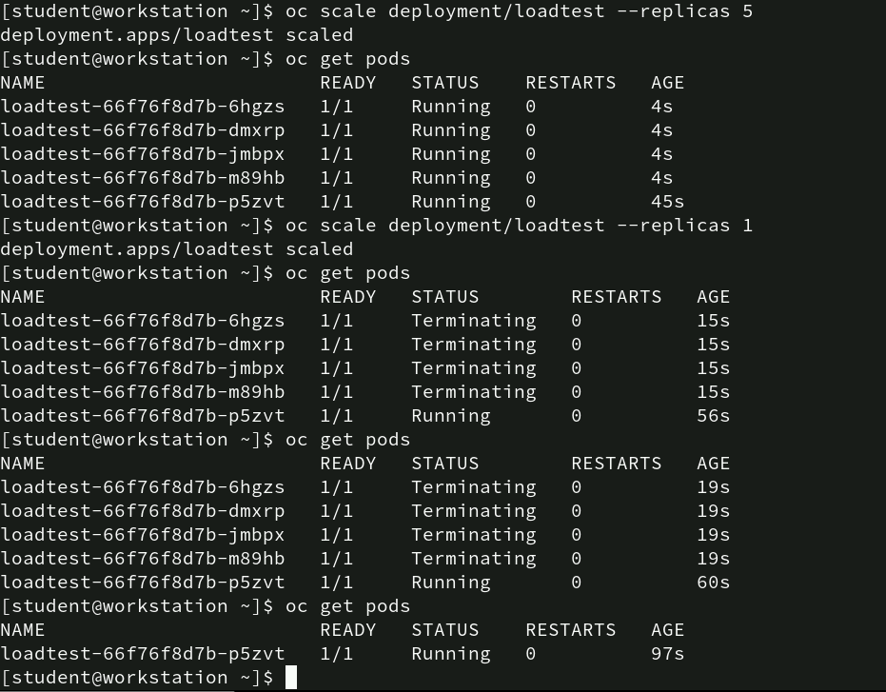
Scaling and Monitoring the loadtest Deployment
• oc scale deployment/loadtest --replicas 5: 5 pod instances of the loadtest application will be running. It ensures high availability or distributes load across multiple pods.
• oc get pods: All 5 pods (loadtest) are running without any restarts, indicating the scaling was successful.
• oc scale deployment/loadtest --replicas 1: This command scales down the loadtest deployment back to 1 replica. This reduces the number of running instances to just one pod.
• oc get pods: The subsequent oc get pods commands show that 4 of the pods are in the Terminating state as the deployment scales down to a single pod.
Analysis: The scaling up and down worked as expected, demonstrating OpenShift’s ability to handle changes in resource requirements dynamically. The pods terminated gracefully during the scale-down process, ensuring smooth adjustment without service disruption.

Slide 62
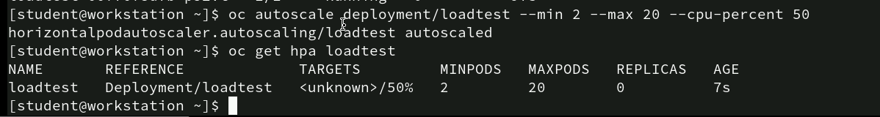
Configuring and verifying horizontal Pod Scaling
• oc autoscale deployment/loadtest --min 2 --max 20 --cpu-percent 50: This command creates a Horizontal Pod Autoscaler (HPA) for the loadtest deployment. The HPA is set to maintain a minimum of 2 pods and a maximum of 20 pods, scaling based on CPU usage. When the average CPU utilization across all pods exceeds 50%, the HPA will scale up the number of pods accordingly.
• oc get hpa loadtest: This command retrieves the details of the HPA configuration for loadtest. The output shows that the HPA is set with a target CPU utilization of 50%, with a range of 2 to 20 pods. The REPLICAS column currently shows 0, indicating no scaling action has occurred yet.
Analysis: The autoscaler is successfully created and is ready to adjust the number of pods based on real-time CPU utilization, ensuring efficient resource allocation for handling variable loads.

Slide 63
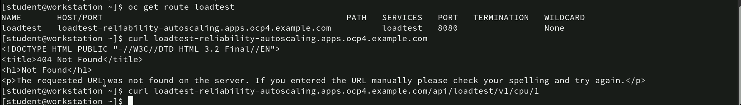
Verifying Route and Endpoint Acccesibility
• oc get route loadtest: This command retrieves the route details for the loadtest service, displaying the HOST/PORT, PATH, and other relevant information. The route is identified as loadtest-reliability-autoscaling.apps.ocp4.example.com with service loadtest exposed on port 8080.
• curl loadtest-reliability-autoscaling.apps.ocp4.example.com/api/v1/cpu/1: Here, the command tries to access a more specific API endpoint for the loadtest service at the /api/v1/cpu/1 path. There is no visible output in the screenshot, suggesting the service might be reachable or pending further response.
Analysis: The loadtest route is correctly created but accessing the root path yields a 404. Specifying a more detailed endpoint (/api/v1/cpu/1) might interact with the application’s intended functionality, confirming the correct route setup and endpoint targeting.

Slide 64
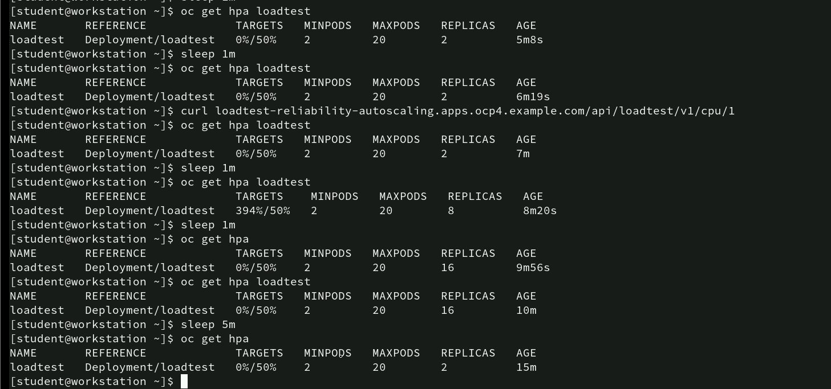
Monitoring HPA behavior
• oc get hpa loadtest: This command displays the current status of the Horizontal Pod Autoscaler (HPA
• sleep 1m: Introduces a one-minute delay before re-checking the HPA status.
• curl loadtest-reliability-autoscaling.apps.ocp4.example.com/api/loadtest/v1/cpu/1: This command triggers a CPU load by accessing a specified endpoint, which is expected to increase CPU utilization for the loadtest pods.
Analysis: The HPA effectively scales the deployment up and down based on CPU demand, demonstrating autoscaling functionality in response to varying workloads, ensuring efficient resource utilization.

Slide 65
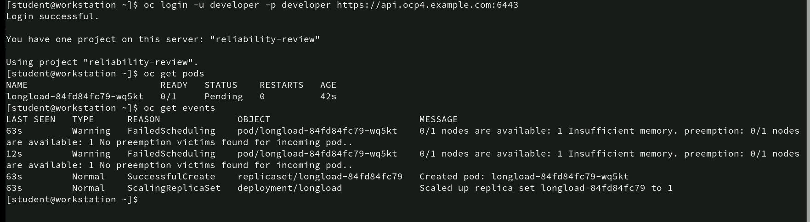
Checking Pod Scheduling and Resource Availability
• oc get events: Lists recent events, revealing two FailedScheduling warnings for the pod due to “Insufficient memory”—indicating the node lacks enough resources to schedule the pod. Additionally, the events show no preemption victims are available to free up resources.
• The Normal events confirm that a replica was successfully created and scaled up, but resource limitations prevent it from running.
Analysis: The pod couldn’t start due to memory constraints on the node. Adjusting the resource requests/limits or adding more nodes with available resources would help resolve this issue.

Slide 66
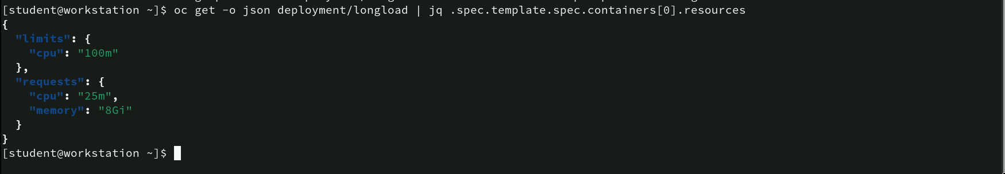
Inspecting Resource Requests and Limits
• oc get -o json deployment/longload | jq .spec.template.spec.containers[0].resources: Retrieves the JSON configuration of the longload deployment and filters to show resource requests and limits using jq.
Analysis: The requests values indicate how much CPU and memory the container requires to be scheduled, while limits define its maximum usage. The high memory request (8Gi) suggests that the container requires significant resources, which may impact scheduling if the node lacks sufficient resources. Adjusting these values can improve scheduling success.

Slide 67
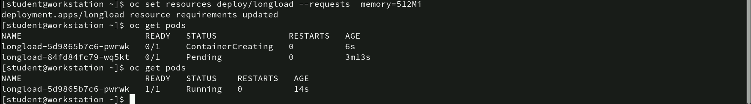
Adjusting memory Requirements for Deployment
• oc set resources deploy/longload --requests memory=512Mi: Updates the longload deployment’s resource request to allocate 512Mi of memory.
• oc get pods: Lists the current status of pods. Initially, longload-5d9865b7c6-pwrrk was in ContainerCreating status, while longload-84fd84fc79-wq5kt remained Pending.
• oc get pods (again): Shows the pod longload-5d9865b7c6-pwrrk successfully running, while the other pod did not start.
Analysis: Adjusting the memory request to 512Mi allowed the pod to be scheduled and run successfully, indicating that the previous memory allocation was insufficient for the container to start correctly. Proper resource allocation ensures efficient pod scheduling and prevents resource-related failures.

Slide 68
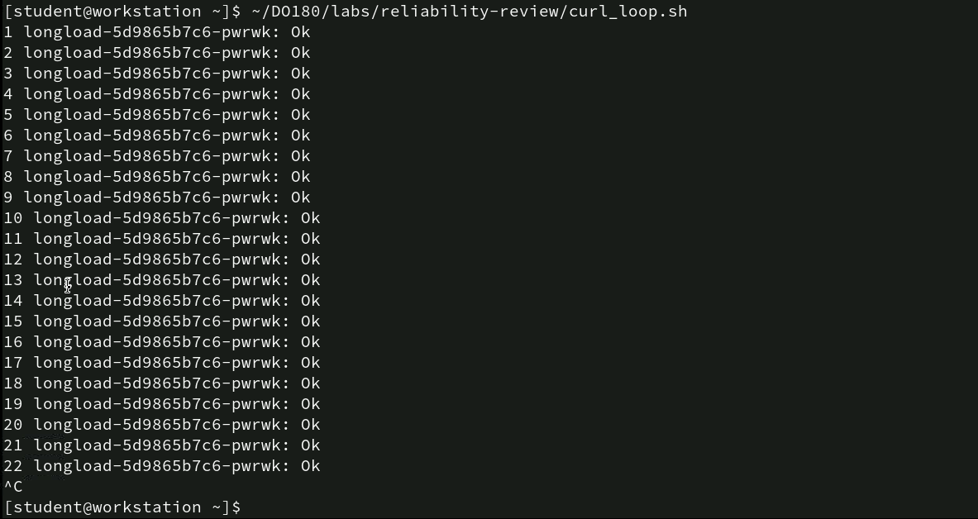
Executing Curl Loop for Pod Health Check
• ~/DO180/labs/reliability-review/curl_loop.sh: Executes a shell script named curl_loop.sh, which sends repeated curl requests to the longload-5d9865b7c6-pwrrk pod.
• Each line outputs the pod’s name along with “Ok,” indicating a successful response to the curl request.
Analysis: The script confirms that the pod is consistently responsive and healthy, showing that it handles requests without any issues during this testing period. This approach is useful for verifying the pod’s reliability under load.

Slide 69
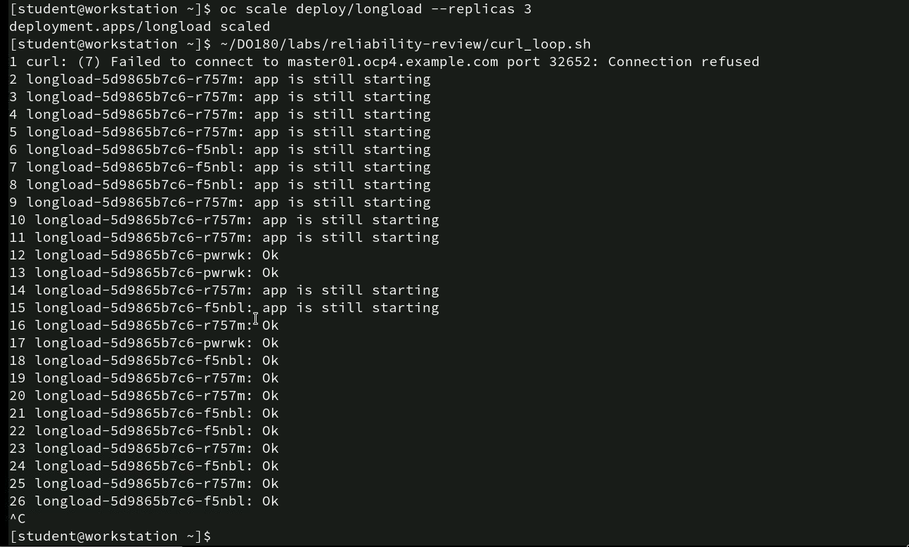
Scaling pods and health Check with Curl Loop
• oc scale deploy/longload --replicas 3: Scales the longload deployment to 3 replicas.
• ~/DO180/labs/reliability-review/curl_loop.sh: Executes a script that sends repeated curl requests to check the status of each pod. The output initially shows “Connection refused,” indicating the service wasn’t ready or accessible. Messages like “app is still starting” suggest the pods were initializing.
Analysis: The sequence highlights how the pods scale up and transition from an initializing state to readiness, showcasing the pod scaling behavior and the importance of liveness and readiness checks in ensuring service availability.

Slide 70
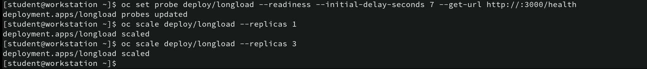
Configuring and scaling Readiness Probe
• oc set probe deploy/longload --readiness --initial-delay-seconds 7 --get-url http://:3000/health: This command sets a readiness probe for the longload deployment with a 7-second initial delay, targeting the /health endpoint on port 3000.
• oc scale deploy/longload --replicas 1: Scales the deployment down to 1 replica.
• oc scale deploy/longload --replicas 3: Scales the deployment back up to 3 replicas.
Analysis: This sequence demonstrates setting up a readiness probe to ensure pods are checked for health before being considered ready. Adjusting replica counts verifies that the deployment can adapt while maintaining readiness checks, ensuring reliable scaling and traffic handling.

Slide 71
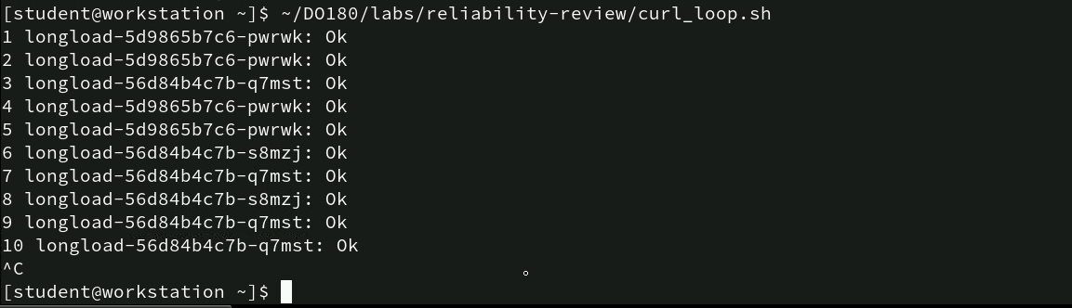
Executing curl_loop.sh
• ~/DO180/labs/reliability-review/curl_loop.sh: This command runs a script that repeatedly executes a curl request to check the status of multiple pods (e.g., longload-5d9865b7c6-pwrwk and longload-56d84b4c7b-q7mst).
Analysis: The script is successfully connecting to different pods and returning “Ok,” indicating that the pods are responsive and healthy. This looped check helps confirm the reliability and responsiveness of the deployed pods over time, ensuring they can handle repeated requests without failure.

Slide 72
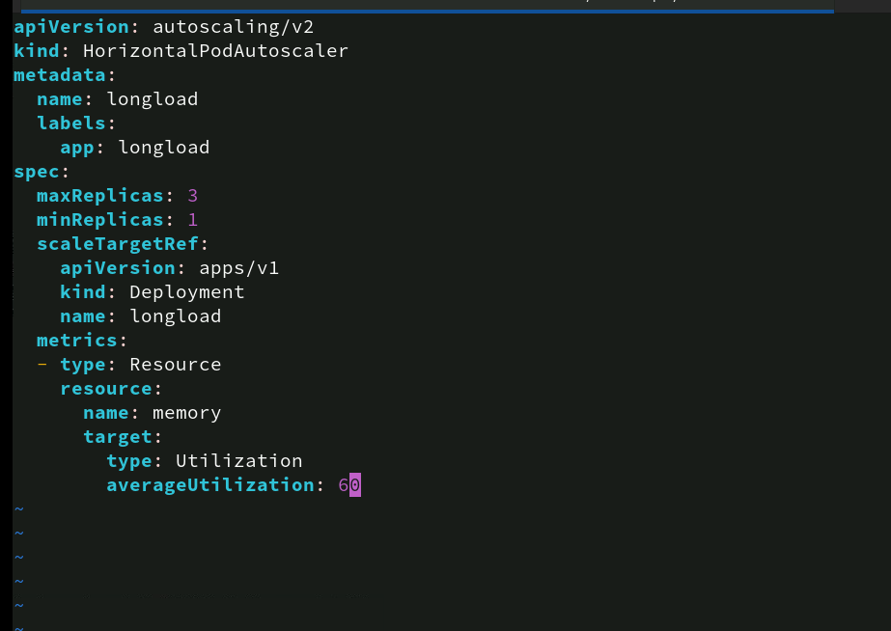
Horizontal Pod Autoscaler Configuration
This configuration ensures that the longload deployment scales between 1 to 3 replicas based on memory utilization. It helps maintain performance by automatically adjusting the number of pods in response to load changes, ensuring optimal resource usage.

Slide 73
Editing the HPA YAML Configuration File
vim ~/DO180/labs/reliability-review/hpa.yml: This command opens the hpa.yml file located in the specified directory using the vim text editor. The vim editor allows for editing and modifying the Horizontal Pod Autoscaler (HPA) YAML configuration file.

Slide 74
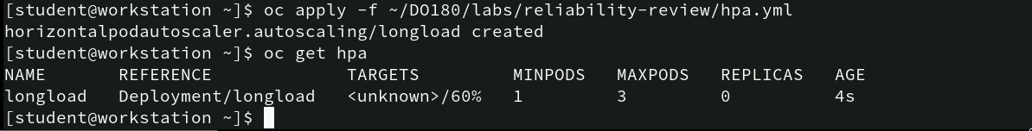
Applying and checking the HPA
oc apply -f ~/DO180/labs/reliability-review/hpa.yml: This command applies the hpa.yml configuration file, creating or updating the Horizontal Pod Autoscaler (HPA) for the longload deployment. The HPA settings are read from the YAML file, allowing Kubernetes to manage pod scaling based on the defined resource metrics.
oc get hpa: This command retrieves the current status of the Horizontal Pod Autoscaler. It displays information about the HPA, such as the deployment it’s monitoring, target metrics, minimum and maximum pod counts, current replicas, and age.
Analysis: These commands set up and confirm the HPA configuration, which is essential for auto-scaling your deployment based on resource utilization. The HPA aims to keep your application’s resource usage efficient by scaling pods between 1 to 3 replicas as per the defined memory utilization target of 60%.

Slide 75
Executing memory Allocation Script
- ~/DO180/labs/reliability-review/allocate.sh: This command executes the allocate.sh script located in the ~/DO180/labs/reliability-review directory. The script appears to force a pod (longload-56d84b4c7b-q7mst) to start consuming additional memory.
Analysis: This action simulates a high-memory load on the longload pod, potentially triggering the Horizontal Pod Autoscaler (HPA) to respond by scaling up the number of pods to handle increased resource demands. This step is useful for testing how effectively the HPA adjusts to changes in memory utilization.

Slide 76
Monitoring HPA changes for longload
- watch oc get hpa longload: This command continuously monitors the Horizontal Pod Autoscaler (HPA) status for the longload deployment. The watch utility runs the oc get hpa longload command at regular intervals, providing real-time updates on the HPA’s scaling behavior, target utilization, and the number of replicas.
Analysis: This approach is effective for observing how the HPA responds to changes in resource consumption over time, such as memory or CPU utilization spikes. It allows you to track scaling events and verify if the HPA is functioning as expected based on the defined metrics and thresholds.

Slide 77

Monitoring HPA Metrics and Scaling Behavior
watch oc get hpa longload: This command continuously monitors the Horizontal Pod Autoscaler (HPA) status for the longload deployment, updating every 2 seconds. The HPA has detected that memory utilization has reached 84%, exceeding the set target of 60%. As a result, the HPA scaled up to 2 replicas to handle the increased load, within the defined limits of 1 to 3 pods.
Analysis: The increase in replica count demonstrates the HPA’s responsiveness to rising resource demands, ensuring the application remains performant as load increases. This automatic scaling helps maintain stability and prevent resource saturation under heavier loads.

Slide 78
Releasing memory and monitoring HPA
~/DO180/labs/reliability-review/free.sh: This script is executed to release memory from the pod longload-56d84b4c7b-2f9t. The message “releasing memory!” indicates that memory resources are being freed up within this pod, likely to adjust the resource usage.
Analysis: By running the memory release script, you’re actively managing the pod’s resource consumption. The subsequent watch command is crucial for observing how the HPA responds to the decreased memory usage, ensuring that the system scales down if the resource utilization drops below the configured thresholds.

Slide 79

Releasing memory and monitoring HPA
The reduction in replicas illustrates the HPA’s efficiency in optimizing resource usage by scaling down when load decreases, ensuring resources are not wasted when demand is low. This dynamic adjustment is key for maintaining cost-effectiveness and efficient resource utilization.

Slide 80
Thank You!

